Slide 1



Deep Learning frameworks

Slide 2
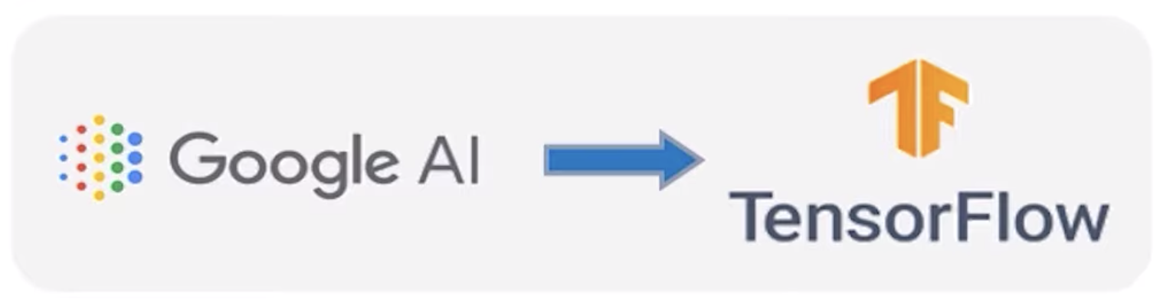
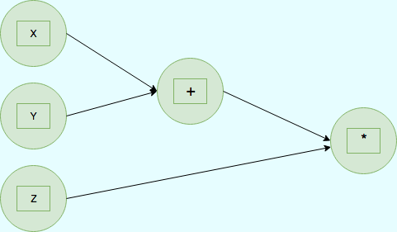
TensorFlow
Low level-software library created by Google to implement ML models and to solve complex numerical problems.
It performs calculations by converting every element into graphical form. The variables of the graph are called Tensors and the mathematical operations are called operators.
Tensors are IMMUTABLE.
Notes:
Symbolic math library based on data Flow and differential programming
More detailed and allows to have more detailed control to manipulate functions .. how to use and implement them.

Slide 3
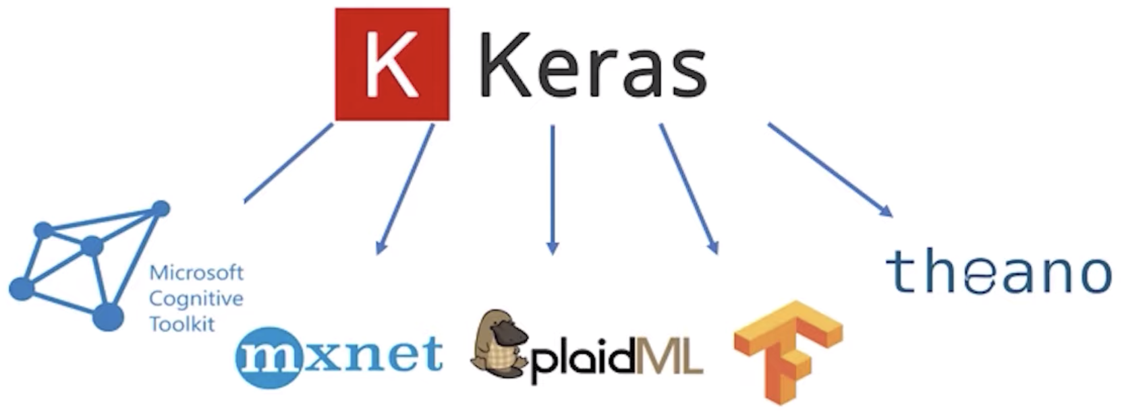
Keras
A high-level deep learning API written in Python for easy implementation and computation of neural networks.
It also integrates with various backend engines to help with fast computation while miniating ease of implementation.
Notes:
Generic provides more functionalities with one command

Slide 4
PyTorch
A low-level API developed by Facebook AI for Natural Language Processing and Computer Vision tasks.
Think of a more powerful version of NumPy.
Emphasizes flexibility and allows Deep Learning models to be expressed in basic Python.

Slide 5
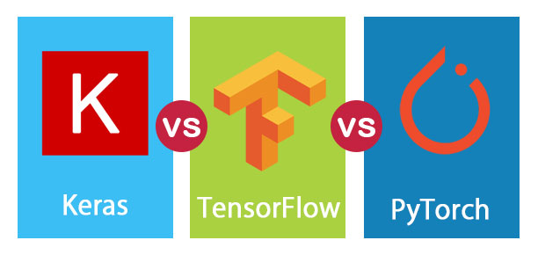

Slide 6
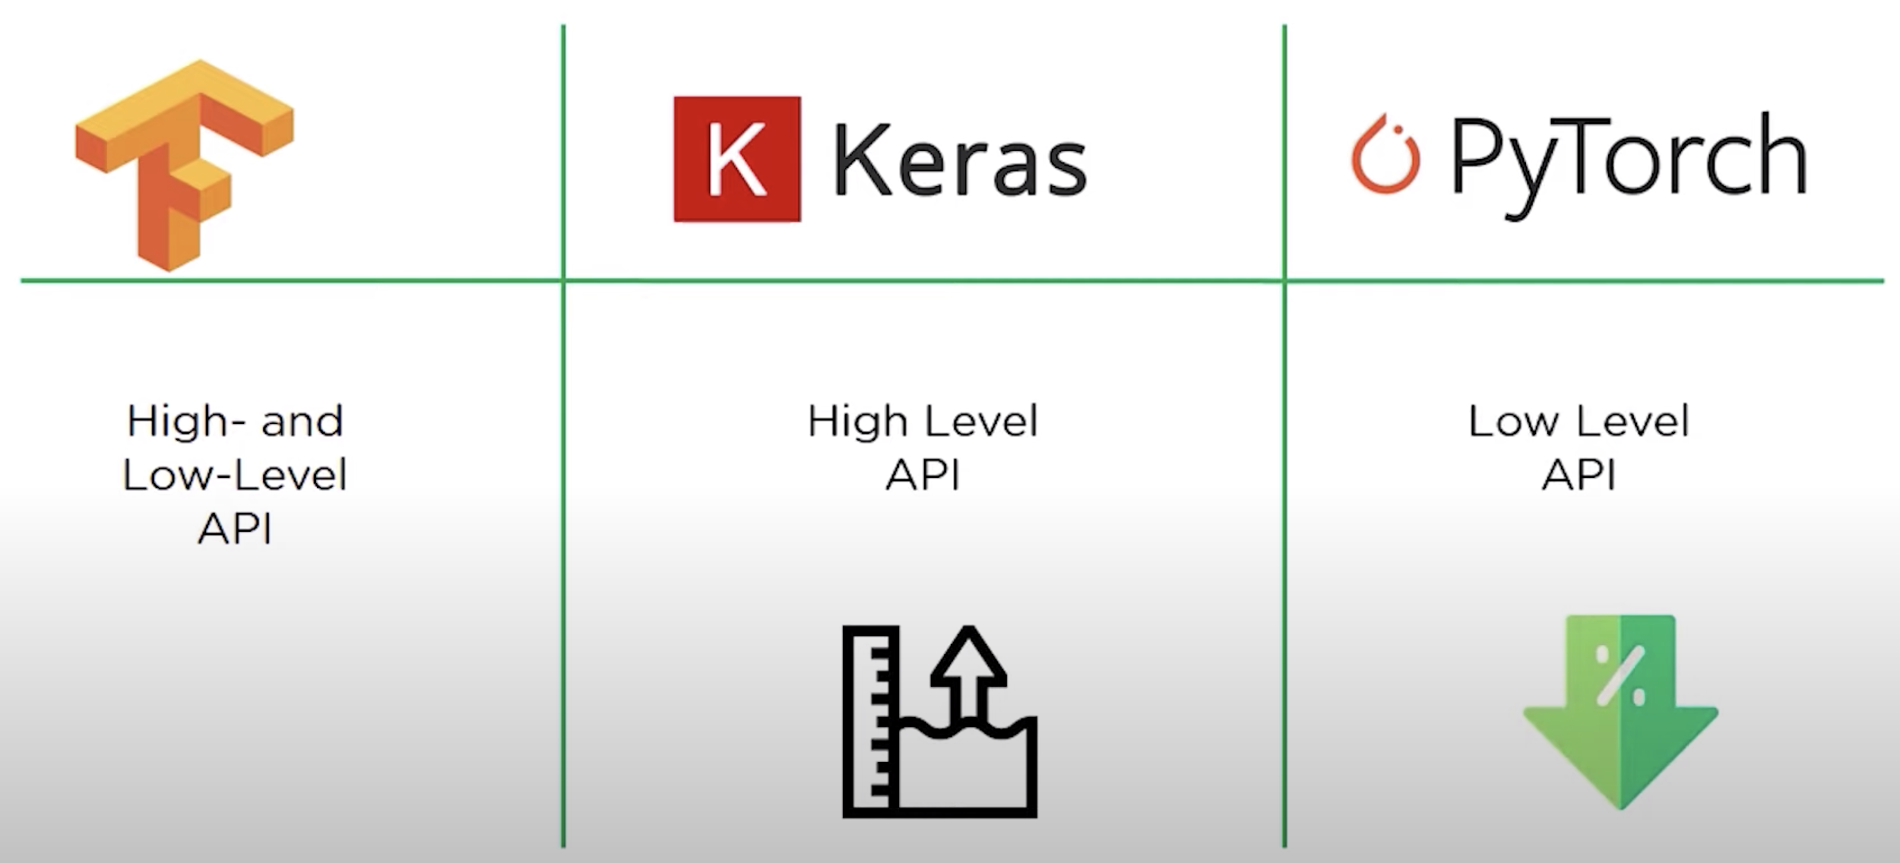
1. Level of API
Notes:
HIGH Level: easy and less involved with the details

Slide 7
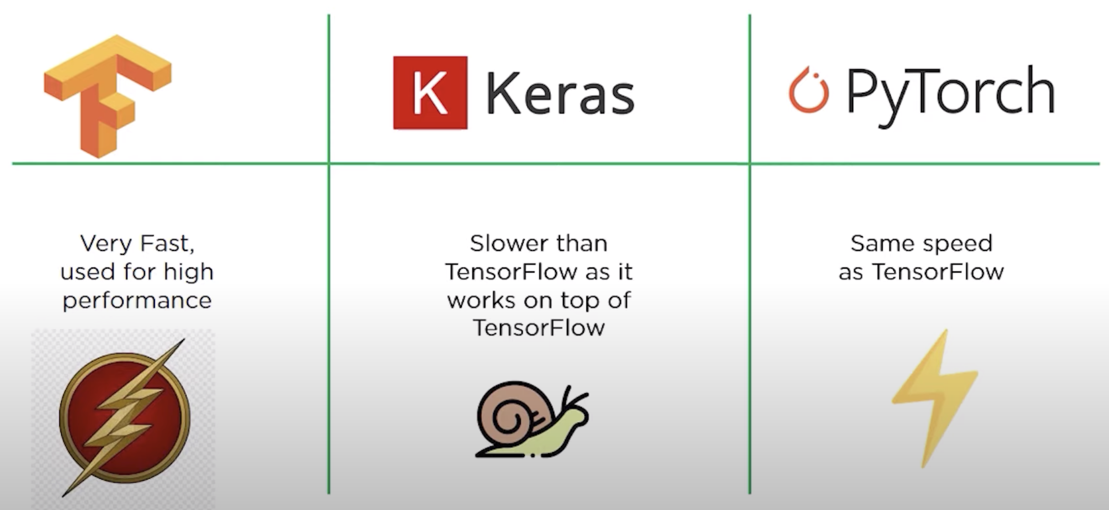
2. Speed

Slide 8
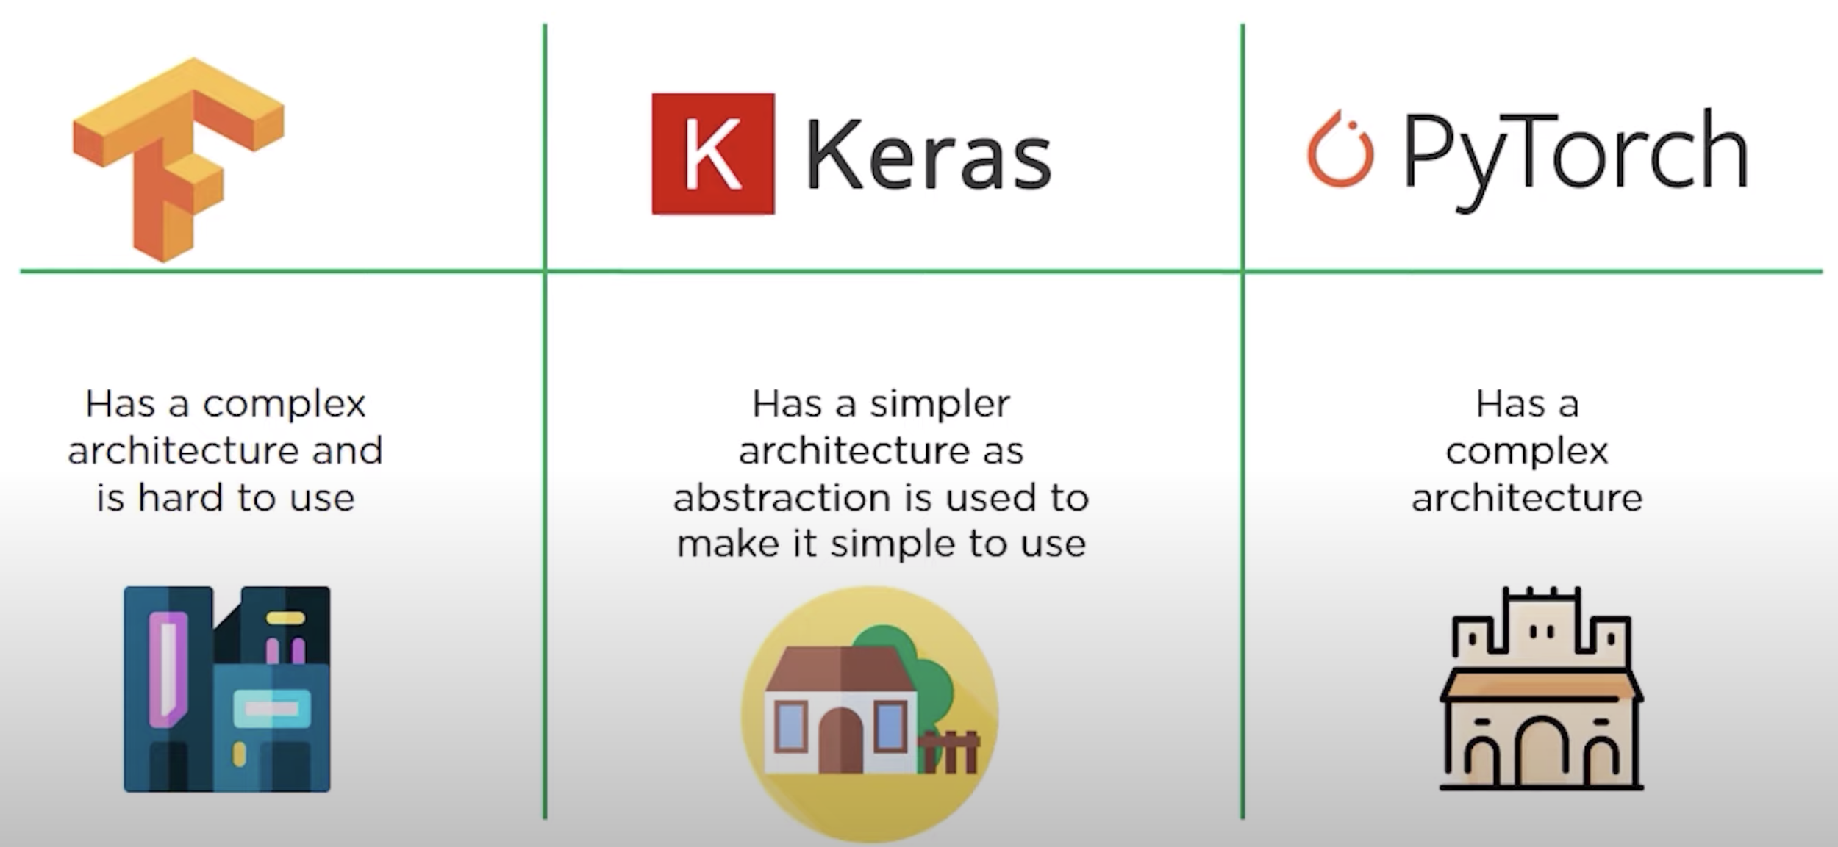
3. Architecture

Slide 9
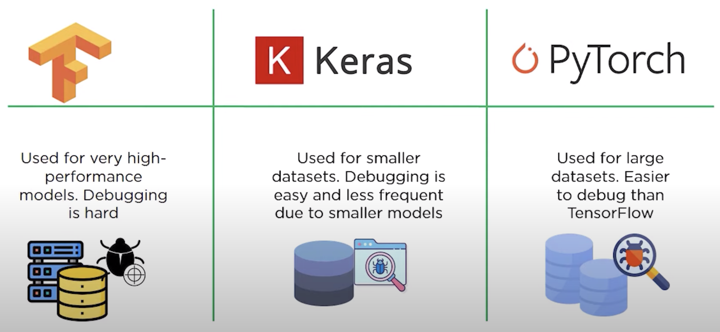
4. Datasets and Debugging

Slide 10
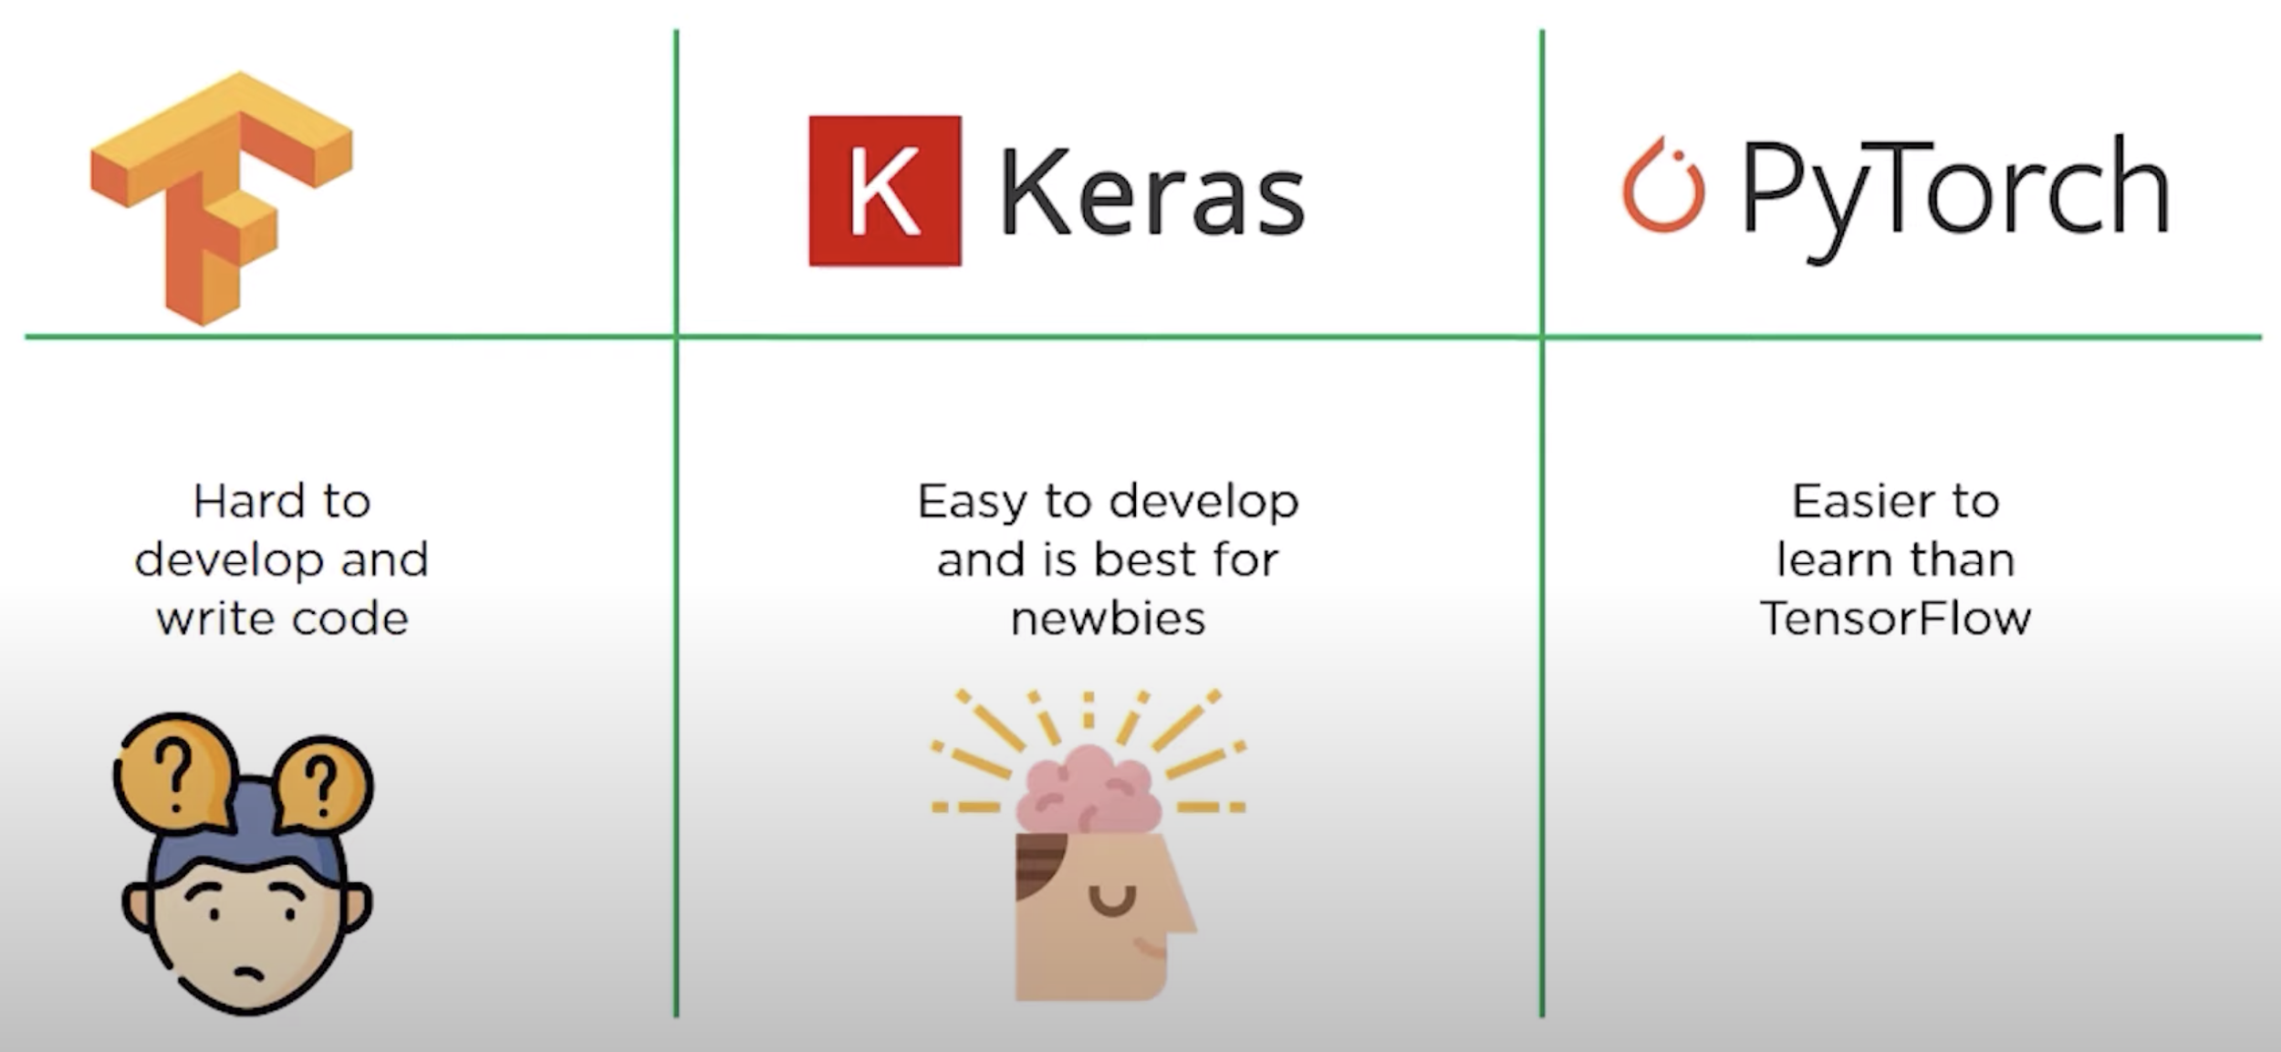
5. Ease of Development

Slide 11
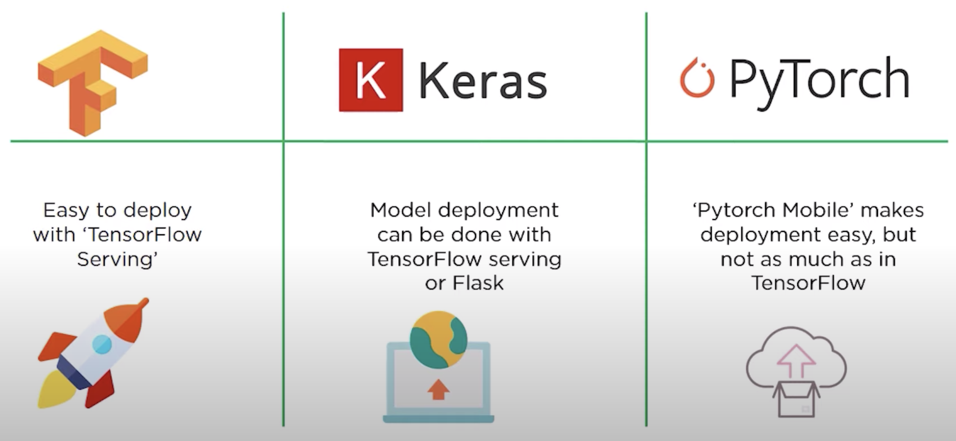
6. Ease of Deployment
Notes:
PyTorch:
seamless process to go from training to deployment by staying entirely within the pytorch ecosystem.
It provides end to end workflow makes it easy to go from research to production.
Privacy … federated learning techniques.

Slide 12
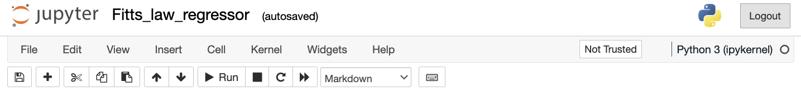
End Point
Width (W)
– Distance (D) –
Starting Point

